Slide 1
Hanging Around, Confused
Fixing the modifiers we abuse

Slide 2
Beginnings
Basic English sentence word order is Subject-Verb-Object (S-V-O)
Jane kicked the ball
Add Variety by using modifying clauses and phrases
Adverbial Clauses/Phrases
Adjectival Phrases
Appositive and Absolute Phrases
*all information came directly from Howard

Slide 3
Adverbial
The clause/phrase functions as an adverb, modifying a verb
Subordinate Clause
Stocks can be a risky investment because they can lose value.
Because they lose value, stocks can be a risky investment.
Stocks, because they lose value, can be a risky investment.
Prepositional Phrase
We eat pancakes for breakfast on Sundays.
On Sundays, we eat pancakes for breakfast.

Slide 4
Quick note
MOVING TEXT CAN ALTER MEANING, SO BE CAREFUL
The test was surprisingly hard.
Surprisingly, the test was hard.

Slide 5
Participles
Participles are verbs (past, present, etc.) used as an adjective
New York City’s subway system, flooded by torrential rain, shut down at the height of the morning rush hour.
Flooded by torrential rain, New York City’s subway system shut down at the height of morning rush hour.

Slide 6
Appositives
These you know. An appositive is noun/noun phrase that modifies another noun.
The governor, New York’s highest official,……
New York’s highest official, the governor,….

Slide 7
Absolutes
Absolutes have both a noun/pronoun and a participle. They modify an entire sentence.
The task finally completed, the workers headed for the parking lot.
The workers headed for the parking lot, the task finally completed.

Slide 8
intermission

Slide 9
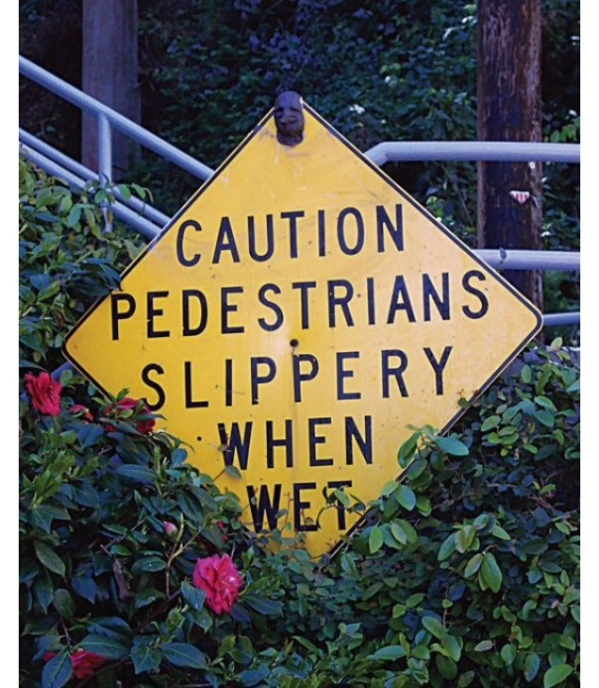
What’s wrong?

Slide 10
Definition
Modifiers are anything that modifies or changes a noun or verb.
They can be single words or clauses and phrases.
Think of all those clauses and phrases we just studied.
*all information came directly from Ballenger

Slide 11
problems
Dangling, misplaced, and squinting modifiers are phrases that are missing words or are not located properly in relation to the words they modify.

Slide 12
Dangling modifiers
A dangling modifier is a phrase or clause, which says something different from what is meant because words are left out.
Incorrect: While turning over the bacon, hot grease splashed my arm.
Problem: Who is turning over the bacon? The answer is not hot grease, as it unintentionally seems to be, but I. The subject I must be added.
TO CORRECT:
Usually adding a word or two makes the sentence clear.
State the subject right after the dangling modifier
Add the subject to the dangling phrase.

Slide 13
Dangling Modifiers
Example #1 Correction
Correct: While turning the bacon, I was splashed by hot grease.
Or
While I was turning over the bacon, hot grease splashed my arm.

Slide 14
Dangling Modifiers
Incorrect: While reading the newspaper, my dog sat with me on the front steps.
Problem: Who was reading the paper? The unintended meaning is that dog was reading the paper. However, the writer was reading the paper.
Correct: While reading the newspaper, I sat with my dog on the front steps.
Or
While I was reading the newspaper, my dog sat with me on the front steps.

Slide 15
Dangling Modifiers
Incorrect: Shaving in front of the steamy mirror, the razor nicked Ed’s chin.
Problem: Who was shaving in front of the mirror? The answer isn’t razor but Ed. The subject Ed must be added.
Correct: Shaving in front of the steamy mirror, Ed nicked his chin with the razor.
Or
When Ed was shaving in front of the steamy mirror, he nicked his chin with the razor.

Slide 16
Misplaced modifiers
A misplaced modifier is a word or phrase describing something but not placed near enough the word it is supposed to modify. Misplaced modifiers often confuse the meaning of a sentence.

Slide 17
Misplaced modifiers
Incorrect: I had to take down the shutters painting the house yesterday.
Problem: It sounds like the shutters painted the house. Place the modifying phrase painting the house near or next to the word it is meant to modify.
TO CORRECT:
Rewrite the sentence so that you place any modifiers as close as possible to the words, phrases, or clauses they modify.
Correct: Painting the house yesterday, I had to take down the shutters.

Slide 18
Misplaced modifiers
Incorrect: He nearly brushed his teeth for twenty minutes every night.
Problem: He came close to brushing his teeth but in fact did not brush them at all.
Correct: He brushed his teeth for nearly twenty minutes every night.
(The meaning--that he brushed his teeth for a long time--is now clear.)

Slide 19
Misplaced modifiers
Incorrect: The professor posted the notes for the students covered in class.
Problem: The modifier, “covered in class,” appears to modify “the students.” Because the students are not covered in class, this is a misplaced modifier
Correct: The professor posted the notes covered in class for the students.

Slide 20
Squinting modifiers
Squinting modifiers appear to modify both what precedes and follows them.

Slide 21
Squinting modifiers
Incorrect
People who study hard usually will get the best grades.
That people who usually study get good grades.
That people who study usually get good grades.

Slide 22
Squinting modifiers
The math department just offers Calculus III at night on Thursdays.
The only class offered on Thursday nights is Calculus III.
(Cal III may be taken at other times as well).
The only time Calculus III is offered is Thursday nights. (There are other classes available at that time).

Slide 23
Sources
Ballenger, Bruce. The Curious Writer. New York: Longman, 2008.
Print.
(All of the modifier information came directly from this).
Howard, Rebecca Moore. Writing Matters: A Handbook for Writing
and Research. New York: McGraw-Hill, 2011. Print.
(All of the phrase/clause information came directly from this)

