Slide 1
Symbolism and Allegory
Objective: Students will be able to define, recognize and explain symbolism, allegory and figurative language.
Q: What does it mean to define, recognize, and explain?

Slide 2


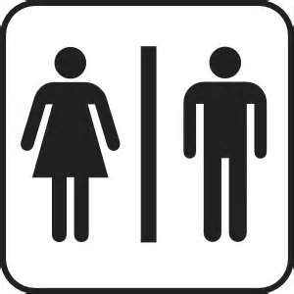
APK (Activating Prior Knowledge)
See if you can explain what the following symbols mean:

Slide 3
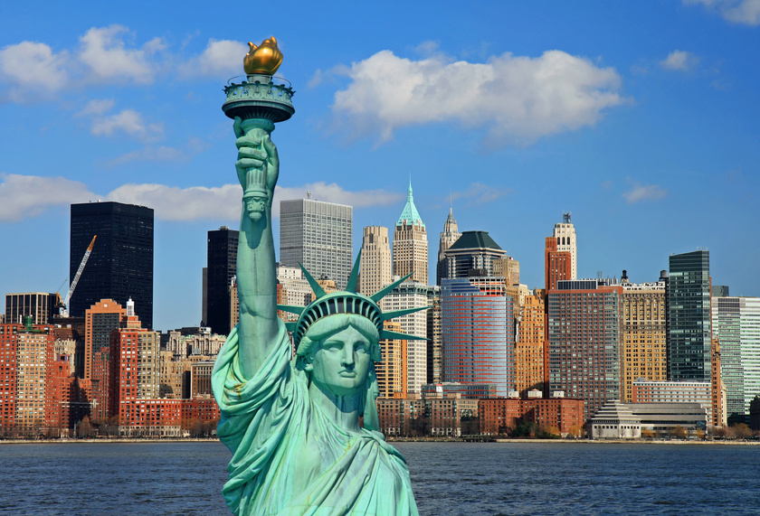
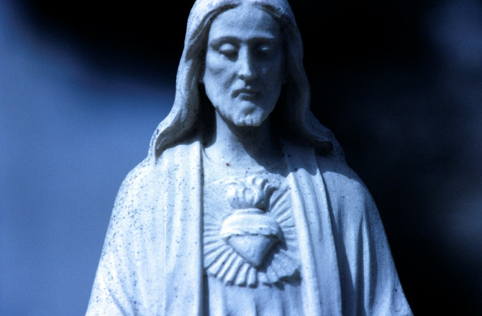

Concept Development: Symbols
A symbol is often an event, object, person or animal to which an extraordinary meaning or significance has been attached.
Pair/share: What ideas do these pictures symbolize?

Slide 4
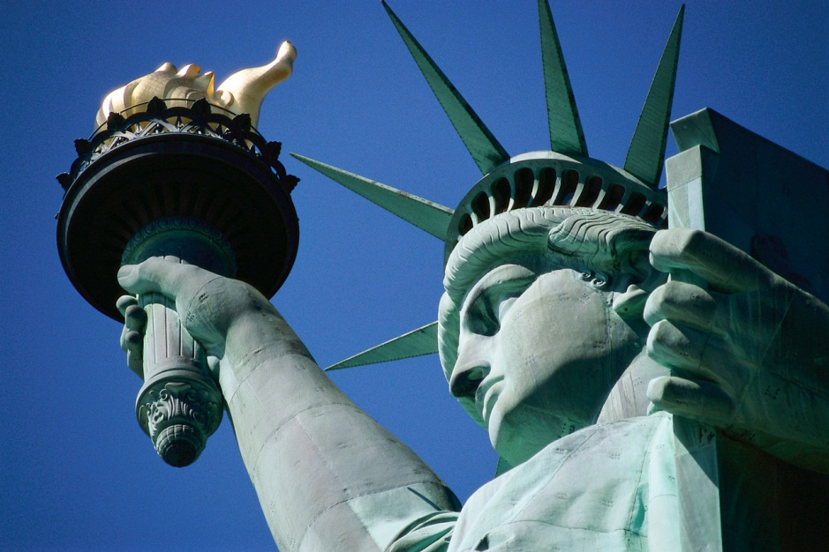
Concept Development:
Where do Symbols come from?
Symbols can be inherited or invented.
Ex. The Statue of Liberty came to symbolize freedom for people immigrating to the United States by way of Ellis Island.

Slide 5
Importance:
Why Create Symbols in literature?
Symbols allow writers to suggest layers of meanings and possibilities that a simple literal statement could not convey as well.
Symbols allow writers to convey an idea with layers of meaning without having to explain those layers in the text.
A symbol is like a pebble cast into a pond: It sends out ever widening ripples.
Pair/Share: Tell your partner a symbol from one of our readings this year or last year.

Slide 6
Concept Development:
Allegory
  An Allegory is a story in which characters, settings and actions stand for something beyond themselves.
  In some types of Allegories, the characters and setting represent abstract ideas of moral qualities.
  In other types, characters and situations stand for historical figures and events.

Slide 7
Examples of Allegories
An Allegory can be read on one level for its literal or straightforward meaning
An allegory can be read for its symbolic, or allegorical meaning
Allegories are often intended to teach a moral lesson or make a comment about goodness and depravity.

Slide 8
Concept Development:
Fable
Type of ALLEGORY, usually has animals
Used to teach moral lessons to children
Animals/characters represent
  Virtues=good human qualities
  Vices=bad human qualities
  **Fables teach lessons about
  life**
Represents arrogance
Represents Perseverance

Slide 9
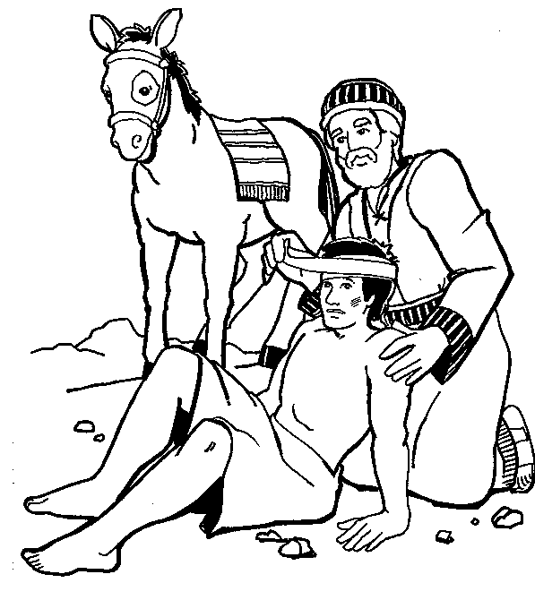
Concept Development:
Parable
Type of ALLEGORY set in the real world
Teaches a lesson about ethics or morality
Remember the Good Samaritan??
-Many stories in the Bible are parables

Slide 10
Concept Development:
Allegory/Parables
Some famous parables and allegorical stories/movies/television programs are:
Animal Farm
“The Emperor’s New Clothes”
The Wizard of Oz
“The Boy Who Cried Wolf”
Avatar
The Matrix
Of Mice and Men

Slide 11

Allegory continued…
In a old English play called Everyman, the main character is named Everyman ( he stands for exactly what his name indicates.)
One day Everyman is summoned by death to give an accounting of his life.
Everyman asks his friends Fellowship, Beauty, Strength and Good Deeds to go with him to tell death that he has led a good life.
Only Good Deeds stays with him until the end.
Pair/Share: What do you think the lesson is from this story?

Slide 12
Symbolism vs. Allegory
A symbol can be a word, place, character or object that means something beyond what it is on a literal level.
An allegory involves using many interconnected symbols or allegorical figures in such a way that nearly every element of the narrative has a meaning beyond the literal level, i.e., everything in the narrative is a symbol that relates to other symbols within the story.

Slide 13
The Poisonwood Bible
With a partner, take five minutes for the following:
1. Identify at least two symbols in the novel
2. Discuss/write about how the novel is a political allegory…relate the story in the book to the history of the Congo we’ve discussed. What details from the book support your ideas?

Slide 14
The Poisonwood Bible
The novel is also a religious allegory.
Their “sin” is an unwillingness to relate to the real world. This is very obvious in Nathan. In recent chapters, we’ve seen the rest try to re-connect to the world.
1. How is each girl and Orleanna guilty of this sin?
2. How are they trying to overcome their “sin”?
3. What are we supposed to learn from each?

Slide 15
Independent Practice
Think of a movie or book that utilizes a symbol (you cannot use an example from this powerpoint!)
  Name the movie/book
  Identify the symbol
  Identify the literal meaning of the symbol
  Identify the figurative (symbolic) meaning of the symbol
  Explain why the symbol was used

